Slide 1
Implementation in Tableau

Slide 2
Why Tableau?
It can connect to a variety of data sources
Local Excel, csv, tab-delimited data files
Data servers
Statistical files including R, SAS, and SPSS data files
It facilitates interactive data exploration and visualizations
It requires very little programming knowledge (none if you are using basic functionalities)
Visualizations can be “published” online and shared via blogs or other websites

Slide 3
Versions
Tableau Public
Free!
Workbooks are saved on Tableau Public’s server rather than locally
Tableau Desktop
Can save workbooks locally
More available data sources
Expensive in general, but free to faculty/students of accredited universities

Slide 4
What Tableau is NOT….
A data management tool! Essentially limited to…
New variable creation
Filtering
R, Python, JMP are much better for heavy ‘data wrangling’
Reshaping (wide to long to wide)
Complicated aggregation
Do your heavy-duty cleaning outside Tableau; save to .csv or data file of choice

Slide 5
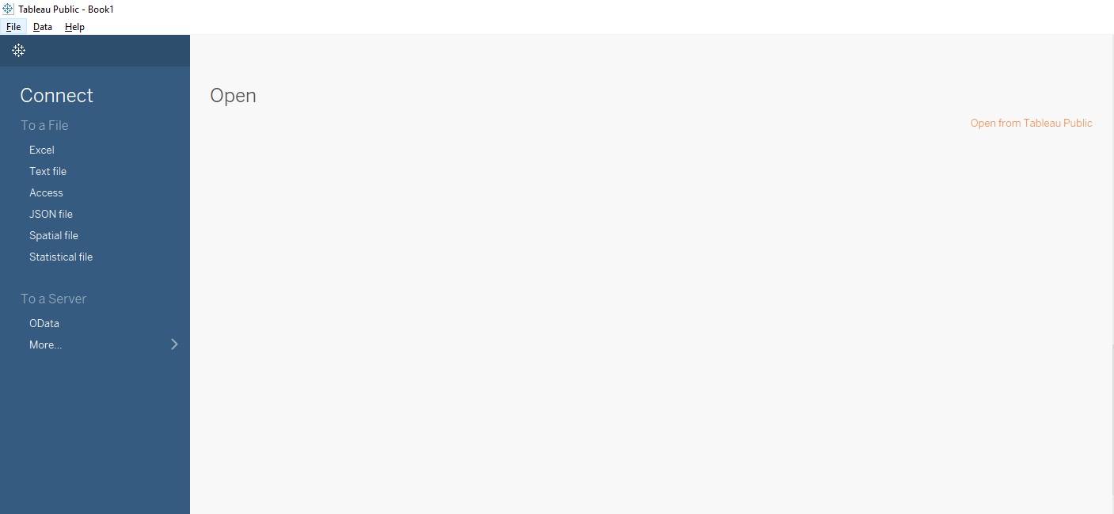
Let’s get started!
The first time you open Tableau, you will see the “Home Page”:
Connect to the World_Bank.csv file, by clicking on the “Text File” option

Slide 6
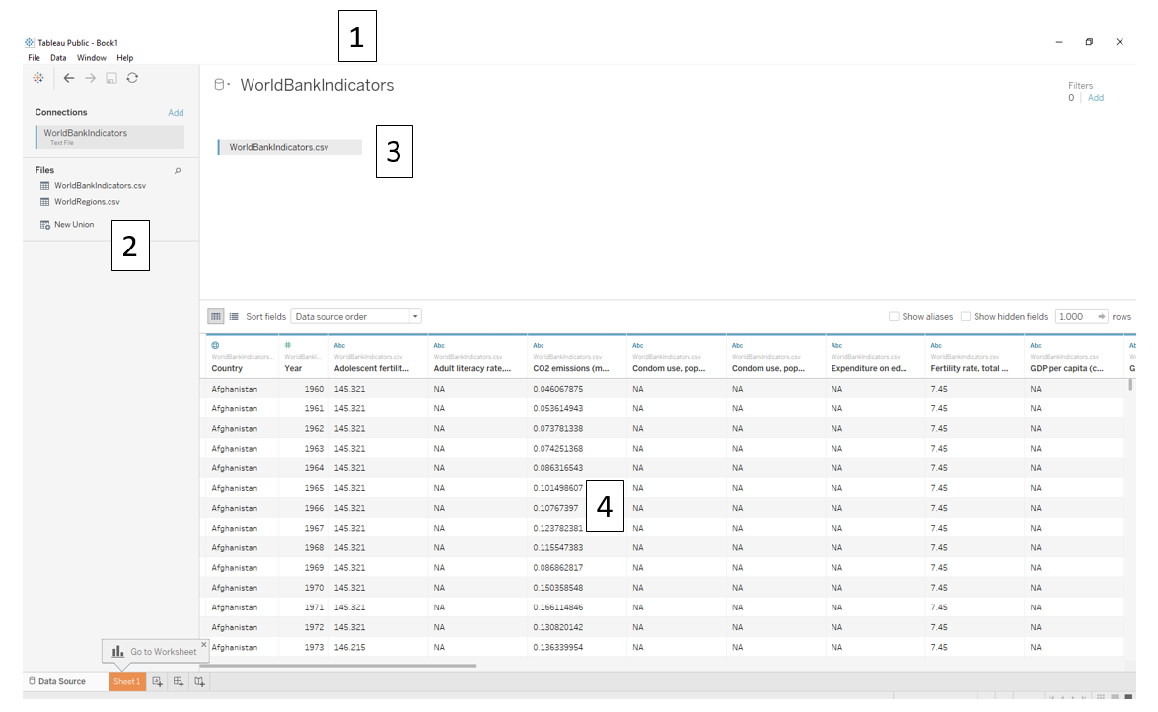
The data file you are currently connected to. Click to rename it within Tableau.
Data sheets in the same working directory of the same file extension.
This is also where names of multiple sheets will show up, if you connect to an Excel file with multiple tabs.
The data sheets you want to visualize: you can click-and-drag sheets from “2” into this space to link multiple data sources.
A view of your data.

Slide 7
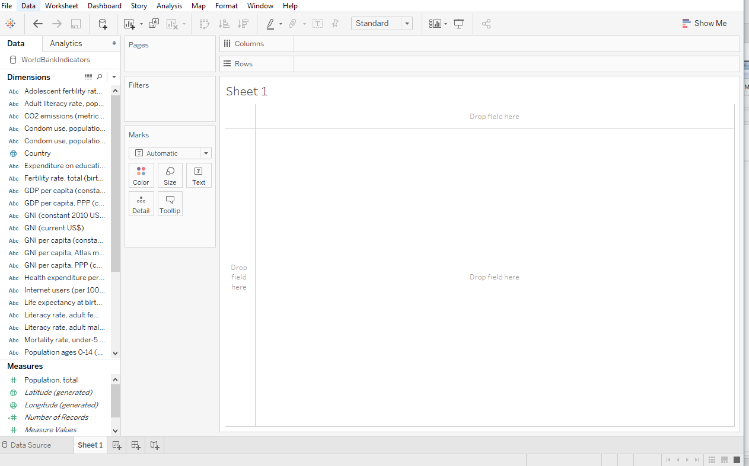
Click on “Sheet 1”:

Slide 8
Tableau vocabulary
Fields
I.e., “variables”; “data columns”
Axes are determined by whether fields are Discrete or Continuous
Aka Categorical or Quantitative
Discrete fields create headers, or discrete bins. Blue pills.
Continuous fields create continuous AXES. Green pills
Aggregation determined by whether fields are MEASURES or DIMENSIONS
Dimensions by default are NOT AGGREGATED
Measures by default are AGGREGATED (summed, averaged, etc.)

Slide 9
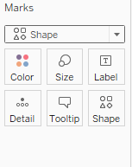

The marks card
Dropdown menu to change geometries
Drag-and-drop variables to map aesthetic attributes
“X”
“Y”

Slide 10
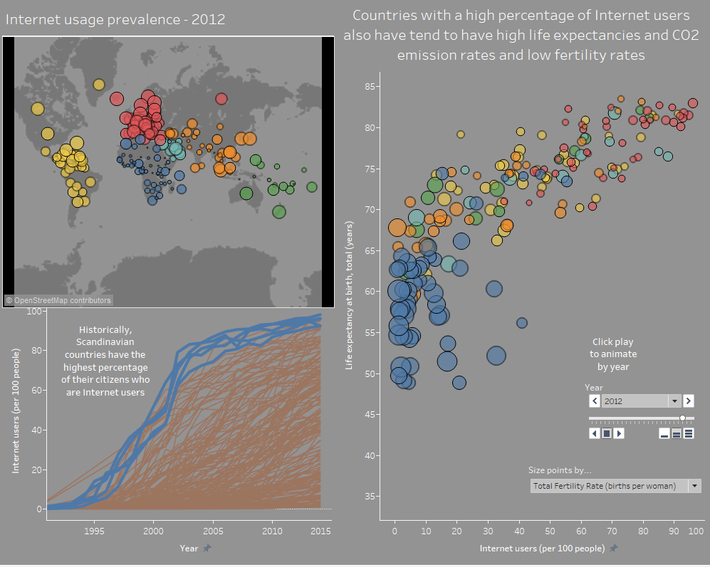
World bank interactive dashboard:
Modified from Chapter 13:
Communicating Data with Tableau
By Ben Jones
Fully interactive version: https://public.tableau.com/profile/silas.bergen#!/vizhome/WorldBankDataVisualizations/Internetusage

Slide 11
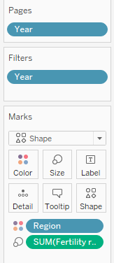

3-way scatterplot
Geom: Shape (circle)
Internet → X
Life expectancy → Y
Fertility rate → Size
Region → Color
Year → Filter
Optional animation:
Year → Pages

Slide 12

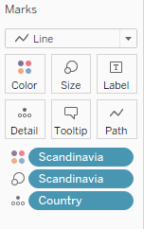
Internet usage by country over time
Geom: Line
Year → X
Internet → Y
Scandinavia → Color
Scandinavia → Size
Country → Detail
Annotate with right click → Annotate → Area

Slide 13
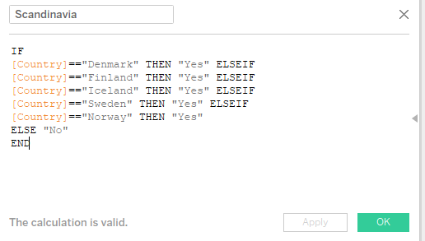
Internet usage by country over time
To create Scandinavia from scratch in Tableau:
Right-click Country → Create Calculated Field
Enter following code:
IF
[Country]=="Denmark" THEN "Yes" ELSEIF
[Country]=="Finland" THEN "Yes" ELSEIF
[Country]=="Iceland" THEN "Yes" ELSEIF
[Country]=="Sweden" THEN "Yes" ELSEIF
[Country]=="Norway" THEN "Yes"
ELSE "No"
END

Slide 14

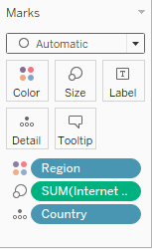

World map of internet usage
Geom: Point
Longitude → X
Latitude → Y
Region → Color
Internet → Size
Year → Filter
Tableau automates with
Country → Detail

Slide 15
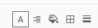
Bells and whistles: The format pane
Right-click → Format
The formatting pane has 5 tools
Right-click sheet name → Copy Formatting to paste formatting across multiple worksheets
Alignment
Borders
Shading
Text
Lines

Slide 16


Dashboard: Bringing it all together
Click New Dashboard:
Arrange worksheets as desired
Use Size dropdown to customize size

Slide 17
Dashboard: interactions
Two important action types
Highlight actions: hovering over a data point on one worksheet highlights corresponding data points on other worksheets;
Filter actions: hovering over or selecting a data point on one worksheet filters corresponding data points on other worksheets.

Slide 18
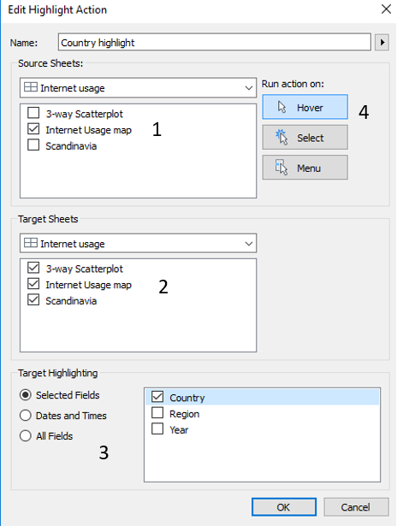
Highlight action
Click Dashboard → Actions…
Add Action → Highlight
Complete the dialogue box as shown. Some things to think about:
From which worksheets do you want the interactivity to be sourced? Select these in the “Source Sheets” box
Which worksheets do you want the interactivity to target? Select these in the “Target Sheets” box
Important: Which fields do you want to control the interactivity? Control this with the “Target Highlighting.” Note that the field(s) you select must be present on all selected target and source sheets for the action to work properly!
Do you want the action to run on hover, or select? Let’s select “Hover” here.

Slide 19
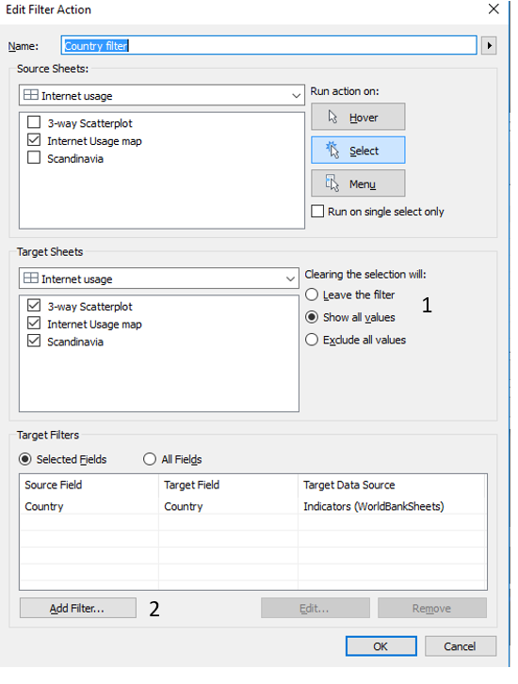
Filter action
Dashboard → Actions…
Add Action → Filter
Set up the Source and Target sheets as before, but note a few new options:
What do you want to happen when the filter is removed? Leave or show all? (I have never encountered a situation where the “Exclude all values” option made sense.)
Filtering by a specified field is accomplished by clicking Add Filter… at the bottom of the dialogue box, and selecting Country.
Set up the dialogue box as shown

Slide 20
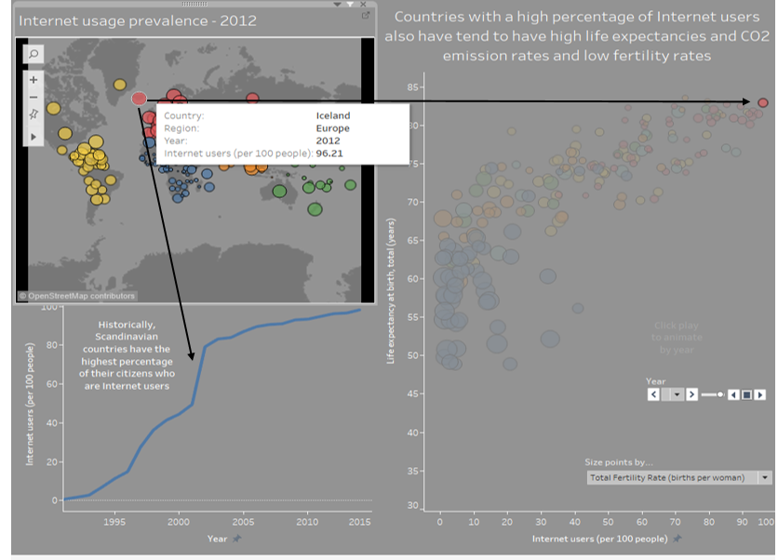
Create!
Reproduce dashboard with interactions indicated by arrows

Slide 21
Publish
File → Save to Tableau Public As…
Share your link: you’re good to go!

Slide 22
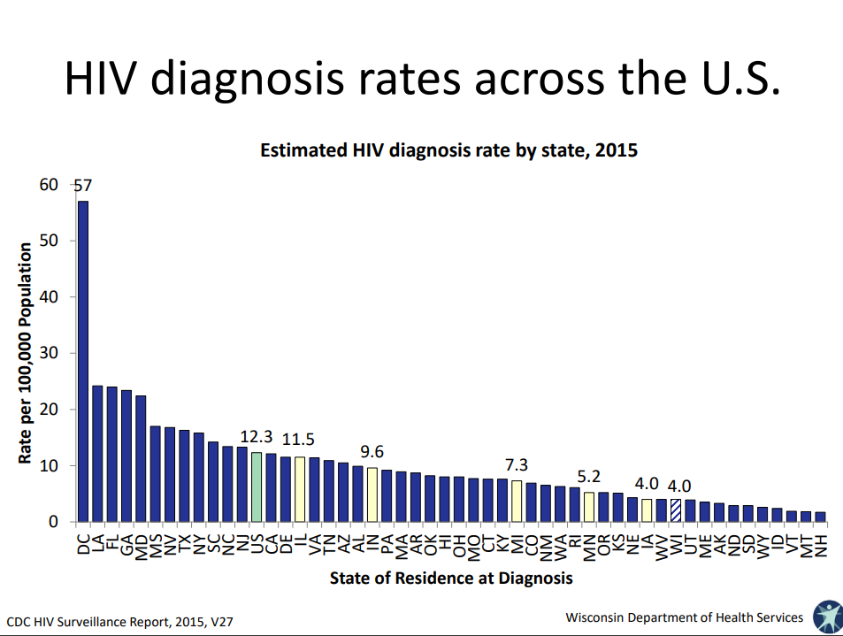
Introductory viz assignment task #1
What appears to be this visualization’s primary message? Is the message clear, the way the visualization is designed?
How could we improve the clarity of its message by employing principles of visual perception?

Slide 23
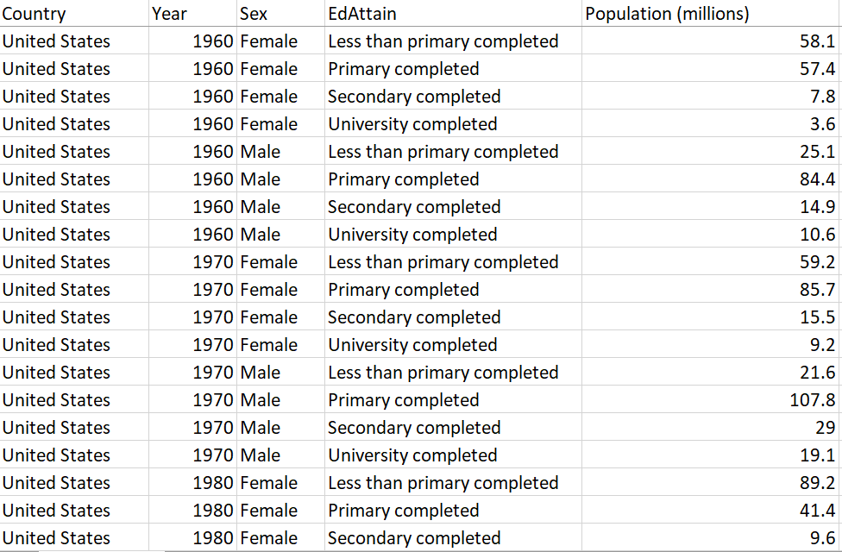

Example “Advanced viz assignment task”
Source

Slide 24
For each question, create a visualization that best answers the question:
Characterize the change in the overall education of the U.S. population over time; is it becoming more or less educated? Staying the same?
Is the gender education gap widening or narrowing?
How do the approaches change if you are required to use all the data (no filtering/aggregating)?

Slide 25


Midterm project
https://thisisstatistics.org/policedatachallenge/
https://thisisstatistics.org/public-health-data-challenge/

Slide 26
Final Project
Students must find their own data
Create “Visual Story”
Presentation to class

Slide 27
 | Complete: 3 | Developing: 2 | Minimal: 1
1. Data source(s) | The data sources visualized are very rich, and required some effort to pre-process. | The data sources visualized are somewhat rich, and/or required minimal effort to pre-process. | The data sources are quite shallow, and/or little effort was made to pre-process.
2. Questions | All questions posed on introductory dashboard are answered. | Most questions posed on introductory dashboard are answered. | Few questions posed on introductory dashboard are answered.
3. Message clarity† | The intended messages and relevant comparisons of all visualizations are obvious | The intended messages and relevant comparisons of most visualizations are obvious | Few visualizations have obvious messages or relevant comparisons
4. Effective comparisons | The most important comparisons are always easy to make. | The most important comparisons are not always easy to make. | Few of the most important comparisons are easy to make.
5. Tidiness | All visualizations show only relevant data features; all visualizations are not “cluttered.” | Most visualizations show only relevant data features; some visualizations are not “cluttered.” | Few visualizations show only relevant data features; few visualizations are not “cluttered.”
6. Annotations | All important data features are highlighted with annotations. | Some important data features are highlighted with annotations. | Few important data features are highlighted with annotations.
7. Cohesion* | Taken together, all visualizations tell a cohesive story. | Taken together, most visualizations tell a cohesive story. | There is very little cohesion in the collection of visualizations.
8. Aggregation | All aggregations are appropriate | Most aggregations are appropriate | Few aggregations are appropriate
9. Legends†† | All legends are used with discretion and enhance understandability. | Most legends are used with discretion and enhance understandability. | Few legends are used with discretion and enhance understandability.
10. Scrolling | No scrolling is required, or scrolling is only used when absolutely necessary. | Scrolling is sometimes required more often than is necessary. | Scrolling is often required in a haphazard fashion.
11. Labels and titles** | All axes and/or legends are clearly labeled and informative. | Some axes and/or legends are clearly labeled and informative. | Few axes and/or legends are clearly labeled and informative.
12. Interactivity (if applicable) | All interactive aspects help convey the data insights. | Some interactive aspects help convey the data insights. | Few interactive aspects help convey the data insights.

Slide 28
Final thoughts
Interactivity is a double-edged sword!
Don’t be discouraged by first attempts
Peer critique is invaluable
Review of experts is invaluable #MakeoverMonday, FlowingData
2 phases; can we emphasize both?
Finding the story
Crafting the story

